Slide 1
Flapjacks, Forums and Facebook
Rethinking Teaching Parenting for Mathematical Resilience
Katie Baker
Notes:
I am going to talk to you today about the support that I provide to parents in helping their children with maths. As you may guess from the title of my presentation this is not the traditional model of resources and talks in school but instead I engage with parents more flexibly and informally in an effort to overcome some of the barriers to parental engagement in maths which I will return to later. But first of all, to get you into the spirit of an Edukate class – I better pass around the cake!

Slide 2
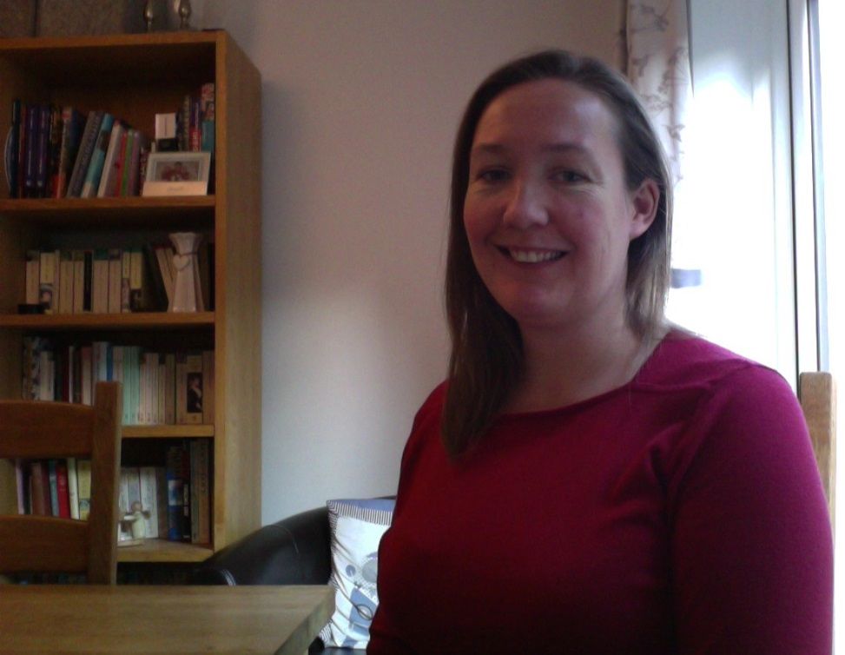
The Background
MY CV
Secondary School Mathematics Teacher
Lecturer at Coventry University and Coventry University College
One to One Support in Coventry University’s Sigma Maths Support Centre
Self-Employed Maths Consultant
Tutoring
Working with apprentices
Classes for parents on how to help their children
Parent
Notes:
I would like to briefly talk about my background in maths education as I feel it holds the key to why my model has developed into what it is today. I started out as a secondary maths teacher but about 10 years ago I left full time teaching to work for myself. In the last 10 years I have been called in by a wide variety of people from Coventry University trying to reach students for whom the maths they needed for their course was way outside their ability to a charity training apprentices who were struggling to get them through their maths test to parents who knew that their child wasn’t going to pass the exam they needed to pass without extra support. And then one day, when trying to come up with a name that summed up everything I was doing it struck me:

Slide 3
For Maths First Aid Call EduKate!
Notes:
I was a maths first aider! And a second thing has struck me over the years. Having seen such a variety of people of different ages and backgrounds struggle with maths, how could I possibly be equipped to help them all? Some of them (particular the one’s at university) were doing maths I had never even seen before and had very little idea about after they had left. It wasn’t the maths techniques I was teaching them that were making the difference. They could get those from anywhere. It was the attitude to maths that I was teaching them to adopt that made the difference. Effectively I was teaching them:

Slide 4
“a positive adaptive stance to mathematics which allows students to continue learning despite adversity” (Kooken et al 2012)
Notes:
I was teaching them MR! Like any good health professional I was not just content to patch up the injured and send them on their way. I wanted to prevent the problem occurring in the first place. But how was I to do that? Having young sons of my own I felt that their attitudes were formed very young. I needed to influence the attitude of the mathematicians of the future as early as possible. And for that I needed to get to the parents!

Slide 5
Traditional assumptions about parental engagement
Child + Parental Help = Child Does Better
Child – Parental Help = Child Struggles
Notes:
I knew parents wanted to help (many of them were paying me hundreds of pounds over the years to ensure their child did well in maths). I was often asked by my friends what they could do to help their . Rosemary’s work among others showed that they were already helping in many ways. Government policy is encouraging parental engagement in maths. These are the assumptions that are traditionally made. But from what I was seeing these equations didn’t necessarily always hold. You may have seen a recent survey by …. which came up with this equation:

Slide 6
Child + Parental Help
=
Child Gets Worse!!
Notes:
How can someone trying to help possibly be making people perform worse. Well after watching my tutees walk away from my house – I had some idea!

Slide 7
The Problem
What they say when they
hire me:
It is so important for her to do well in maths.
I really want to help him because he won’t get a job without maths but I don’t know how.
What they say as they walk down the drive:
I was useless at maths at school.
I can’t do maths myself so I know where she gets it from.
Oh algebra. I hated algebra. When are you ever going to use it anyway.

Slide 8
Parents’ Time < Job + Homework+ Clubs + Family Time + Time to do anything about maths
Parents’ Ability < Maths Homework expected by the teacher.
Parent + Child + Maths Homework = Tears + Stress + Complete Family Breakdown!
Notes:
There was some other equations I was hearing about both from my friends with children and finding in the literature too. You may have heard them (or experienced them) as some of the main barriers to parental engagement with maths.

Slide 9
Parents + Child + Homework
=
“a completely different method from the one I taught them which has confused the child even more”
Notes:
And then there is the one you hear from teachers.

Slide 10
Different Assumptions
If a parent doesn’t know how to help in maths rather than being a neutral influence they are actually being a negative influence.
Many parents need less to do not more.
Many parents (even ones who can do maths) do not feel confident to help with school maths.
I will only have one chance to engage with a parent and I want that engagement to make a difference to all the interactions they have with their child around maths for the rest of their life.
Many parents did not feel comfortable in the maths classroom the first time around and do not want to return.
Notes:
So what do I do differently. First of all my basic assumptions are very different. Here they are:

Slide 11
Different Methods
If a parent doesn’t know how to help in maths rather than being a neutral influence they are actually being a negative influence.
Parents need less to do not more.
I tell parents what they need to stop doing.
Notes:
And these assumptions lead my classes to take certain forms. I tell parents what they need to stop doing. Whether it is saying they were bad at maths themselves, or stepping in too early to help or even doing the child’s homework for them we talk about the things they are doing that are detrimental to their child doing well.

Slide 12
Different Methods
Many parents (even ones who can do maths) do not feel confident to help with school maths.
I will only have one chance to engage with a parent and I want that engagement to make a difference to all the interactions they have with their child around maths for the rest of their life.
I teach about Mathematical Resilience rather than maths.
Notes:
My classes may include maths techniques if that is what the parents want but that is not the main thing I teach. Instead I teach about the principals of Growth, Value, Struggle and the need for Resources and encourage them to hep their child become self-reliant when they get stuck with their maths.

Slide 13
Different Methods
Many parents did not feel comfortable in the maths classroom the first time around and do not want to return.
Any interaction takes place in a non-threatening environment.
Notes:
My classes take place in their home or mine with coffee, tea and homemade cake. That cake is an essential part of the class because the distribution of refreshments at the start breaks the ice and gets people talking about their children and maths naturally. We discuss things among ourselves, more like a parental support group than a lecture. I also run a Facebook page on which I post information about how best to help children with maths. I now have 126 followers with some posts reaching up to 400 people. I tried having a forum but this didn’t work. People like to post their questions anonymously to me on Facebook rather than discuss them in an open forum.

Slide 14
Different Outcomes?
Notes:
But you may ask, what is the evidence that my ideas work? Do my methods have different outcomes?
At the minute the answer is I am not sure. Anecdotally the parents who have attended my classes have found great benefits from them in terms of interactions around maths and their children’s ability to solve their own maths problems. It sounds like they are helping their children to become more resilient. But I am very aware that I need to do something to substantiate my claims. In Spring last year I undertook a pilot of my course to try to gather some evidence.

Slide 15
The Pilot
4 parents – 3 Mum’s and a Dad all with at least 1 child in Year 1.
4 sessions of an hour and a half, each one with a MR theme (Growth, Struggle, Value and Resources) - explicitly discussed.
All participants and their children measured before and after on the Kooken MR Scale and the Betz Maths Anxiety Scale
Notes:
The pilot was made up of four parents …

Slide 16
What the participants said they gained
Increased awareness of what their children were learning at school.
Increased confidence in helping with maths.
Encouraged them to be more involved in helping with maths.
Gave them something to refer back to when working on homework with their children.
Notes:
I surveyed the parents after the course and this is what they felt they had gained.

Slide 17
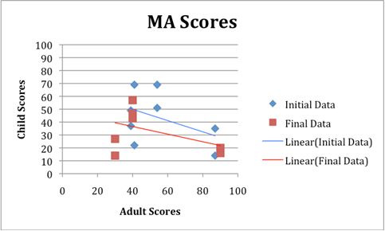
The Results
Notes:
In terms of the results from the scales, the MA scores fell after the course showing the parents and children were less MA although this change was not statistically significant.

Slide 18
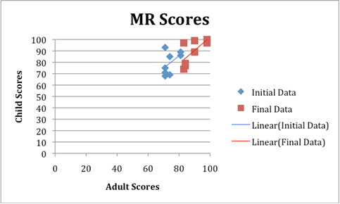
The Results
Notes:
The MR scores rose after the intervention meaning both parents and children were more MR although again this finding was not statistically significant.

Slide 19
The Statistics
Interactions with children around maths were up by 41%.
Related Samples Wilcoxan Signed Rank Test showed statistically significant difference between the children’s MR scores before and after the intervention, p= .017
Children’s Mean MR Score increased from 79.5 to 89.
Notes:
In particular interactions that were not purely around homework had increased. However what was statistically significant was the change in the children’s MR scores.

Slide 20
What next?
Was this change in the children caused by the course? Need to do a trial with a control group.
Can it be replicated?
Will it be retained over time? Need to do a longitudinal study.
Notes:
This pilot raised more questions for me than it answered. Obviously we can not assume casuality from this result. The change could have been caused by external factors rather than their parents attendance of the intervention. It could be a short term result prompted by what their parents had been saying to them. I need to see if this progress can retained over time. In September I began a Research PhD in the department of Pscychology, Behaviour and Achievement in order to look at answering these questions. I am going to rigourously test my ideas and hopefully show that they work.

Slide 21
Get involved:
My Facebook Page (please sign up):
https://www.facebook.com/promotingMR/
If you are a parent please could you complete my online scale here:
https://coventry.onlinesurveys.ac.uk/parentsurvey
Follow me on Twitter: @edukatemaths
Email: bakerk11@uni.coventry.ac.uk
Notes:
If you would like to keep up to date with how I am getting on or be involved in anyway – I am currently looking for schools and parents to volunteer to take part in trials of my questionnaire for children and courses and for parents to complete online surveys you can find all the details here. I would love to chat with any of you afterwards. For now, thank you very much for your time. Are there any questions.

