Slide 1
Developing Mathematical Resilience in KS4 Mathematics
Chris Chisholm

Slide 2
My school
Started as Director of Mathematics in 2009
Big issue with Maths results in 2008- 43% A*-C
Analysis showed the bulk of our students were on a D
Changes to curriculum, staff CPD, staff allocation, early entry, revision days increased results to around 65% A*-C.
Needed a way of increasing this further.
In year following my research interventions results rose to 72%

Slide 3
What were the main issues with our students who were on a grade D?
Upper/ middle school system
Past experience of poor maths teaching
Must keep working on timetables until they get them
Labelled as failures- bottom set
Used to being spoon-fed
Scared of making mistakes
Used avoidance techniques
Blamed others/ the activity for their own perceived failure

Slide 4
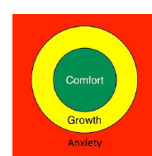
Johnston-Wilder & Lee’s Growth Zone Model (2013)

Slide 5
Mathematical Resilience
Lee and Johnston-Wilder (2013, 2015) consider resilience to be made up of four aspects. These are:
Understanding how to work at mathematics
Awareness of the support available
Understanding of the personal value of mathematics
Belief that the brain capacity can be grown

Slide 6
Main intervention tools
Use of Guy Claxton’s Building Learner Power model
Development of a stuck poster
Building up a strategy tool kit to support them with being stuck
Providing support to encourage them into the growth zone

Slide 7
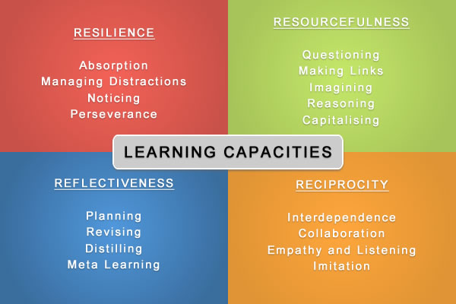
BLP- the four Rs
Use of split screen objectives

Slide 8
The Stuck Poster
On display in the classroom
Was a working document
Students were encouraged to refer to it
Students said they found it useful

Slide 9
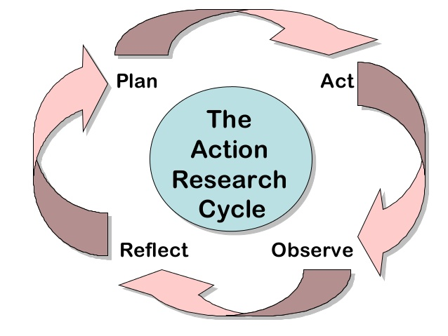
Methodology
Action research

Slide 10
Methods of data collection
Use of pre-post tests –compared to previous cohort
Analysis of exam question compared to previous cohorts
Observation –recorded researcher journal
Discussions in classroom
Interviews
Questionnaires
Student journals

Slide 11
Student journals- bookmark prompts
Describe what you did today.
How do you feel about the problem?
What went well?
What would be even better if …?
What did you learn?
How did you go about tackling the problem?
Did you have a go? What did you try?
Did you carry on when others gave up?
Did you make suggestions?
Did you try to think of different things that might help?
What did you learn about solving problems?
If you got stuck
What did you get stuck on?
Did you think you might have made a mistake?
How did you unstick yourself?
How did you feel when you were stuck and how did you feel when you became unstuck?

Slide 12
The interventions
Intervention one: plotting coordinates
Intervention two: planning a trip
Intervention three: drawing straight line graphs
Intervention four: investigating straight line graphs
Intervention five: the data handling cycle
Intervention six: statistical investigation
Intervention seven: exploring the number grid
Intervention eight: the history of mathematics
Intervention nine: real life problems

Slide 13
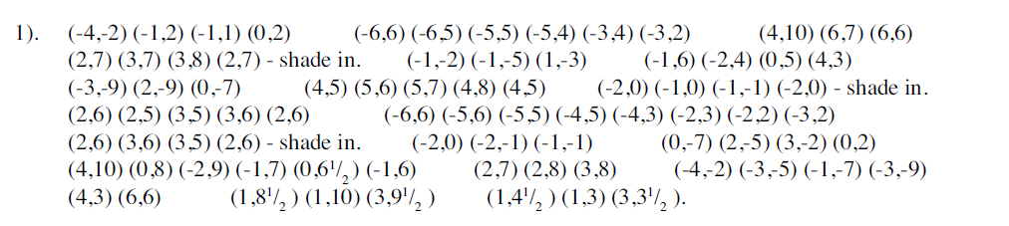
Intervention one: plotting coordinates
‘Plot the points below and join them up in the order shown. Where you see a gap or begin a new line, start a new part of the shape. Do not join this to the previous coordinate.’

Slide 14
Outcomes
When I suggested that he read the instructions at the top his response was ‘why can’t you just tell me what to do’
‘The teacher would not help me when I got stuck and made me ask another student. I wasted lots of time waiting for help so I didn’t get the picture finished. The worksheet was boring and a waste of time because I will never need to use coordinates in real life.’

Slide 15
Intervention two: planning a trip
‘On the Wednesday during the half term holiday, the Learning Support Assistant and I would like to travel to London to see the Matinee performance of the Lion King. We will be leaving our cars at school and would like to make our way there using public transport. Following the show we would like to go for dinner before returning home. We need a schedule for the day, telling us how we are going to get there, the times of transport and details of how much it will cost us’.

Slide 16
Observations
Many started at the beginning of the day. This resulted in us missing the show.
‘It was good planning a trip to London. It was something that I did before although I am not sure what it has got to do with maths’
Other were not so positive

Slide 17
Intervention 3: Drawing straight line graphs
Focus was on them looking carefully at information given
I wrote an equation of a straight line on the board and shared a solution with the class
Students had to look carefully at what I had done and work out what happened at each step
Students were then asked to draw another line

Slide 18
Outcome
Before the question was written on the board ‘How am I meant to do it if I don’t get what you have done?
‘this is pathetic’
‘We’ve given up. I don’t know what we need to do. I’ll get it when you go over it later’
‘my teacher at High School tried to do things like this with us but we never got them so she gave up giving us them to do. I used to try hard but I will never be good at it so I don’t see what the point is in doing them’.
He once again said he liked it more when we did ‘proper maths’ referring to examples given by the teacher followed by completing a work sheet.

Slide 19
Should I give up?

Slide 20
Intervention eight: the history of mathematics
Aimed at a group of girls who were predicted grade D is Maths but A/A* in History and Humanities
Students were asked to select a Mathematician from a list
For the selected mathematician students were asked to:
Talk about their life
Give an overview of the work they did in mathematics
Describe one piece of mathematics they worked on in detail

Slide 21
Outcomes
The girls really enjoyed this way of learning because researching for an essay was something they were confident in doing
One of the girls spoke about how she did not realise that Pythagoras’ theorem could be used so much in real life.
She commented about how her dad, who was a builder, could use the theorem to work out the length of fascia boards without climbing up a ladder.

Slide 22
Advice for those wanting to try something similar
Don’t give up
It can take a while to embed change
Stuck poster was mentioned a lot by students
Adapt planning until you find what works for your group
Split screen objectives helped focus them

