Slide 1
Resourcefulness for Mathematical Resilience?
Dr Els De Geest
Notes:
Abstract
Many of the mathematics research projects I have been involved in over the years included an aspect of developing resilience in learning. National Numeracy, where I am currently involved in research, monitoring and evaluation, believes a change in attitude about value of maths, growth mindset and resilience is needed to improve levels of numeracy, and this is monitored and evaluated in all the activities and projects of National Numeracy.
Recent research we conducted with focus groups of 18 to 24 year old adults with low attainment in mathematics suggests that although these young adults might take a positive stance towards the value of mathematics, believe in a growth mindset and have the will to be resilient, they seem to lack a resourcefulness to be or become mathematical resilient. This presentation will (start to) explore what kind of resourcefulness could be useful and needed for learners of any age to become mathematical resilient.

Slide 2
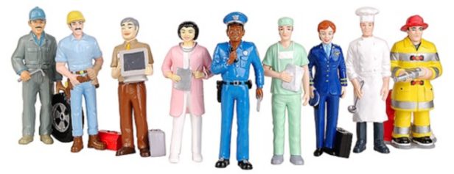
The aims of National Numeracy...
Change public attitudes to maths
Improve numeracy in the UK

Slide 3
Numeracy in the UK…
About 1/2 of UK adults at similar levels to those expected of children at primary school
Over 3/4 of the adult population are working at a level below the minimum expected standard of school leavers

Slide 4
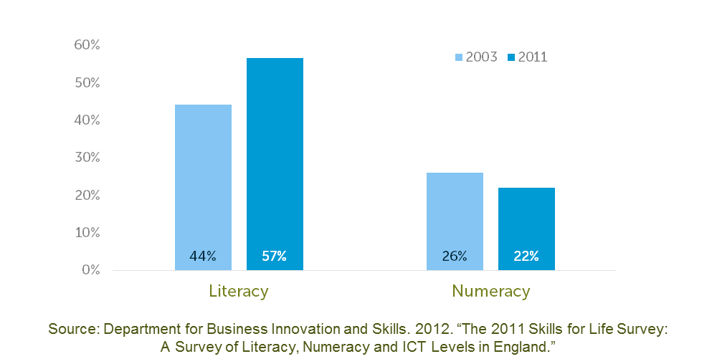
Literacy improved, numeracy got worse…
Adults with Skills Equivalent to ‘C’ or Above at GCSE in England

Slide 5
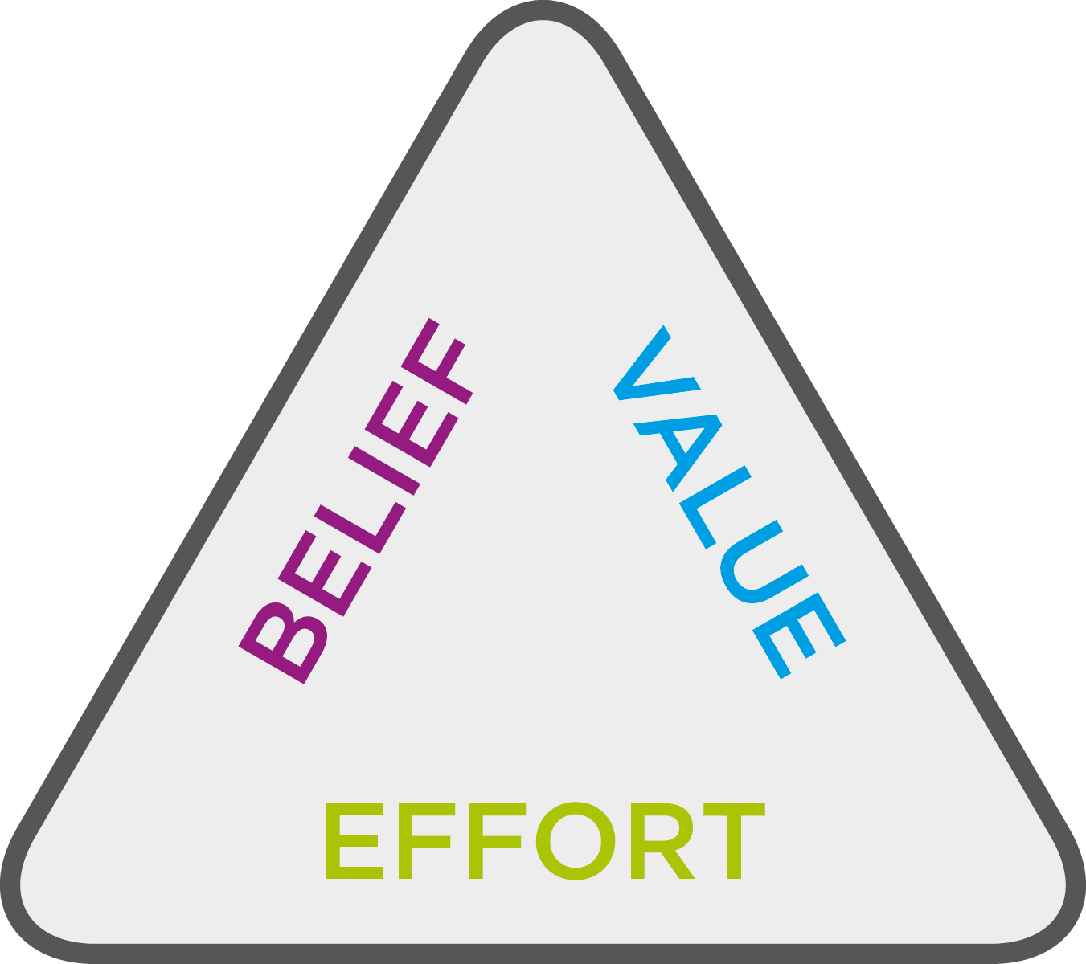
How to improve the level of numeracy - attitudes needed…
See the value of maths
in everyday life
Have a ‘can-do’
attitude
Know that
ability is not fixed
See the benefits of
Improving numeracy
Know that everyone
struggles before they succeed

Slide 6
That means that in our M&E we look for change in…
Belief in growth mindset (Carole Dweck)
Mathematical resilience (Lee and Johnston Wilder)
Struggle in maths is OK (Kooken et al)
Value of maths (Kooken et al)
Maths anxiety (Betz)
‘Numerate behaviour’ (our approach, based on what we call the ‘essentials’, influenced by Cuoco, Polya, Mason,...)

Slide 7


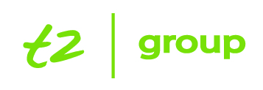
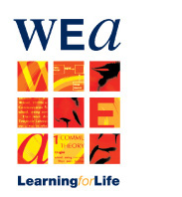








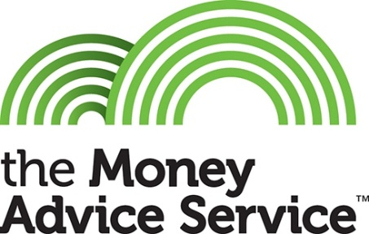






Most of our work is in the adult learning space - some of the our partners are…
Notes:
Some projects, also ‘The Challenge’ which has about 30 000 users per year, and increasing

Slide 8
So what we are after in terms of mathematical resilience…
For people of all ages, in the UK, to be mathematically resilient in their daily life, at work, in educational settings.
To address issues and reactions like this....
[video clip]
http://www.bbc.co.uk/iplayer/episode/b055cym1/week-in-week-out-cant-read-cant-do-my-sums

Slide 9
Clare Lee and Sue Johnston-Wilder on mathematical resilience
The term ‘mathematical resilience’ is defined as
that quality by which some students approach mathematics with confidence in a successful outcome to their effortful work, persistence in the face of difficulty and a willingness to discuss, reflect and research.
(Lee and Johnston-Wilder, 2013)
Notes:
Show
0.00 – 0.25
2.25 – 4.45
15.15 – 16.15

Slide 10
Clare Lee and Sue Johnston-Wilder on developing mathematical resilience skills
Students must have the opportunity to:
Learn sufficient mathematical vocabulary and ways of expression to engage in mathematical conversations
Make mistakes and take wrong turns, so that ultimately develop the belief that if they persevere they will be far more likely to succeed.
Extend their ability to experiment and try out ideas in a mathematical environment and, in our experience, discover that they enjoy it.
Seek solutions to significant problems
Acquire a reflective and thoughtful stance towards mathematics.
(Lee and Johnston-Wilder, 2013)

Slide 11
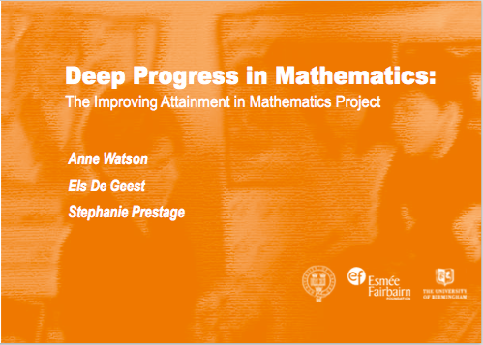
Els totally subscribes to this....
These ideas resonate with findings from her research with low attaining students and from research and work on professional development of teachers.
See for example:

Slide 12
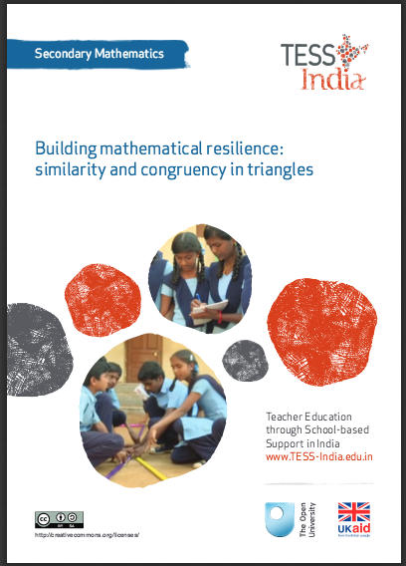
Development of materials to develop MR skills – for example TESS-India, 30 OER teacher PD in maths units

Slide 13
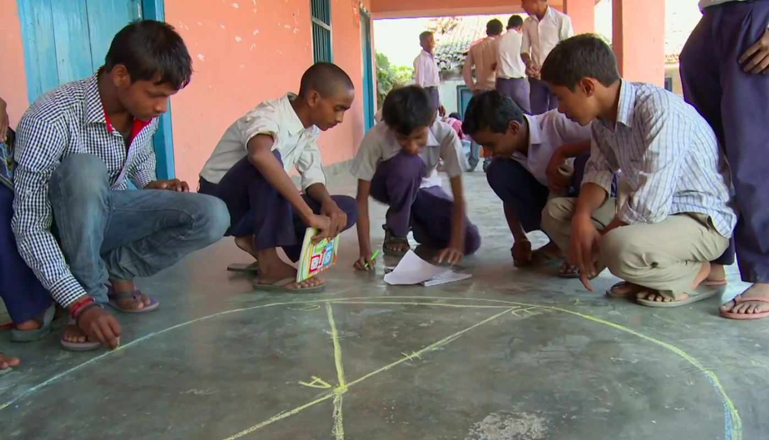
This is one of the activities in the unit that asks the students to work on:
‘Equal chords of a circle subtend equal angles at the centre’
‘Two triangles are congruent if two sides and the included angle of one triangle are equal to the two sides and the included angle of the other triangle (SAS congruence rule)’
Video http://www.open.edu/openlearnworks/mod/oucontent/view.php?id=57108&section=5
Notes:
So believe this, and have been using this to develop materials and tasks. For example the TESS-India materials that Clare and I worked on

Slide 14
A quote about the effect of using the maths TESS-India materials
From a maths teacher in Uttar Pradesh in India that used the maths OER:
"Overall attendance in my classes has increased.
In particular, more girls attend my maths lessons, led by one girl who decided to attend and brought along others (this girl has now passed up to the next year and continues to study maths and science).
Exam results have improved in the areas where students were familiar with the topics.
I have much more enjoyment of teaching. The students respect me more as a teacher. Our relationship has improved.
Boys who have passed out of my year now come back to ask if they can help me set up my classroom."

Slide 15
One of our projects: Mobile Maths
Funded by the Ufi Trust to develop a mobile-phone based set of games to help 16 to 25 year olds improve their numeracy.
Paul Milner, project manager, says:
"Our target audience has not been equipped for the numeracy they will need in adult life - for one reason or another, classroom maths has failed them. The mobile phone app we're creating won't be like school maths, but will focus on the key skill of being numerate. ”
Notes:
Something happened to make me think.
Will talk later about what it means this ‘being numerate’

Slide 16
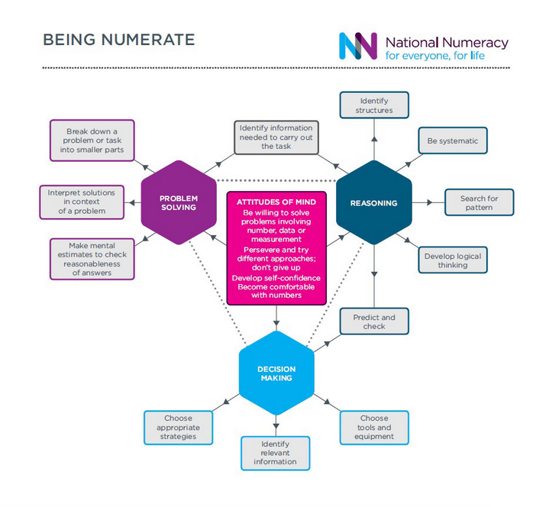
At NN we work on this with the ‘essentials of being numerate’- the game app will focus on this

Slide 17
The ‘essentials’ mean that for being numerate you need activities that give you the opportunity to do these things:
When I am given a maths task....
I am happy to decide for myself how to tackle it
I can decide what information that I need and what information I can ignore
I am happy to play around with it.
I can come up with my own theories and test these out.
I look for patterns and connections.
I think ahead about what I am going to do before I start working out the answer.
I can translate/represent a real situation into maths language and translate it back [this is about mathematical modelling]
I work systematically through it
I know whether I am making good progress or not to solving the problem.
If I think I have found a solution to a maths problem, I check it to make sure it makes sense in the context of the problem.
I can discuss and describe my work to others so they understand.

Slide 18
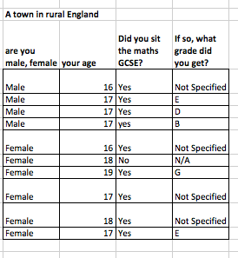
These is one of the Mobile Maths focus groups…

Slide 19
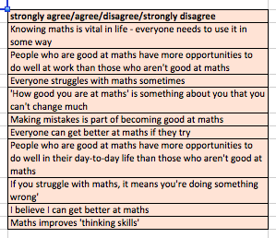
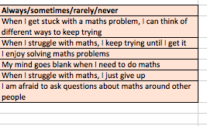
Mobile Maths – the ‘attitudinal’ questions we asked
What would you expect the responses to look like?

Slide 20
From the Mobile Maths Focus Groups we learned…
And this made us all think....

Slide 21
From the Mobile Maths Focus Groups we learned…
And this made us all think....

Slide 22
This Mobile Maths Focus Groups made me think…
The beliefs people hold about value of maths, growth mindset and their MR is somewhat more complex than I expected
To develop mathematical resilience for life, is working on growth mindset, value for maths, struggle by using ‘good’ mathematical questions really enough? Or are we missing something?
Also, can it be done in the short term activities that we at NN do?

Slide 23
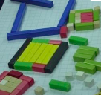
Something else to make us think –
Research by Alison Barnes on perseverance in mathematical reasoning
The mathematical activity of paths around a square pond with
year 6 students:
led to an increasingly systematic approach to specialisation
(Mason et al., 2010)
there was very little evidence of the eight children conjecturing,
generalising or convincing and hence limited perseverance
in mathematical reasoning.
there was urgency in the children’s speech and actions, pleasure in spotting patterns, frustration when trials were unsuccessful and excitement in establishing a systematic approach;
overall, the children reported enjoyment of the activities and the challenge.
(Barnes, 2015)

Slide 24
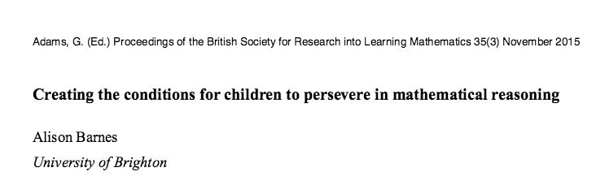
Resourcefulness of mathematical resilience in that research?
So resilience – yes
Mathematical resilience – ?
Resilience/perseverance in mathematical reasoning – no
Did the activity equip the learner to be resourcefulness for mathematical resilience, including mathematical reasoning, in life - doubtful

Slide 25
Proposition: to extend the definition of MR of Lee and Johnston-Wilder on mathematical resilience
The term ‘mathematical resilience’ is defined as
that quality by which some students people approach mathematics, including mathematical reasoning, with confidence in a successful outcome to their effortful work, persistence in the face of difficulty and a willingness to discuss, reflect and research.
For this, people need to develop a resourcefulness for mathematical resilience so that possibilities on how to be mathematical resilient come to mind throughout their life.
)
Notes:
I propose to

Slide 26
Resourcefulness for resilience…
At this conference, we are all working, or interested in working, on building mathematical resilience.
Looking at some of the titles for sessions this conference that aim to build mathematical resilience in learners:
Building resilience through a growth mindset
Coaching for mathematical resilience
Talking to build mathematical resilience
Developing mathematical resilience with student teachers

Slide 27
Resourcefulness for resilience…
The challenge:
How can we ensure what we do in our work on MR will equip learners with the resourcefulness for mathematical resilience, including mathematical reasoning, ‘for life’?

Slide 28
Thank-you!
For a newsletter, or if you would like to stay involved ... http://www.nationalnumeracy.org.uk/register-updates

Slide 29
References
Barnes, A (2015) Creating the conditions for children to persevere in mathematical reasoning. In Adams,G. (Ed.) Proceedings of the British Society for Research into Learning Mathematics 35(3) November 2015
Betz, Nancy E. (1978). Prevalence, distribution, and correlates of math anxiety in college students. Journal of Counseling Psychology, Vol 25(5), 441-448. doi: 10.1037/0022- 0167.25.5.441
Kooken, J., Welsh, M., Mccoach, B., Johnston-Wilder, S. and Lee, C. (2013) Measuring mathematical resilience: an application of the construct of resilience to the study of mathematics. In: AERA 2013, San Francisco, California, 27 Apr-1 May 2013
Lee, C. and Johnston-Wilder, S. (2013) ‘Learning mathematics –letting the pupils have their say’, Educational Studies
in Mathematics, vol. 83, no. 2, pp. 163–80
TESS-India, Building mathematical resilience: similarity and congruency in triangles,http://www.open.edu/openlearnworks/pluginfile.php/134980/mod_resource/content/3/SM05_AIE_Final.pdf, available under Creative Commons Attribution-ShareAlike (http://creativecommons.org/licenses/by-sa/3.0/; unless identified otherwise).

