Slide 1
Developing a whole school approach
to challenging perceptions of the nature of Maths across the school
Andy Croft Matt Hill
acroft@bower-grove.kent.sch.uk mhill2@bower-grove.kent.sch.uk
Maths Subject Leaders
Bower Grove School
Maidstone

Slide 2
Who are we?
Special School in Kent
210 students aged 5-16
Students with
SEMH & Cognition difficulties
50% students have ASC diagnosis
Notes:
BGS Maths: In the past: printing off assessment schemes and expecting them to be complete – what year curriculum? Very little use of concrete apparatus, despite very low attainment of students – 100 squares, whiteboards and counters – Abacus Evolve
Now: Yr1: Raise the profile of Maths – Focus days/staff CPD/calculation guidance
Yr2: Large investment in manipulatives. Problem solving staff CPD. Parents attendance (10%). Democracy focus day. Start of POTW.
Yr3: STEM focus day (1/2 term project), POTW, exploring how we can do Mastery and MR @BGS, exploring
Mastery – Mike Askew in OUP materials – said it sort of worked in special school – but sort of didn’t.
Sometimes hard to find guidance on what works with our non-neruotypical students

Slide 3
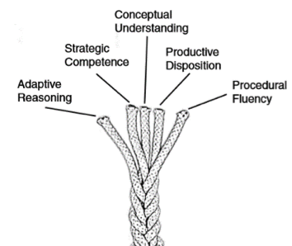
How can we (as a school) apply principles of Maths Resilience & the Mastery agenda to our Special School Environment?
Mastery and Maths Resilience on the School Development Plan
(Kilpatrick, Swafford and Findell, 2001, p.115, cited in NRich. 2015)
Taken from Nrich response to Mastery. 2015

Slide 4
Perceptions of Maths at Bower Grove
Staff & Students
Notes:
Thick black lines
http://www.cne.psychol.cam.ac.uk/the-relationship-between-maths-anxiety-and-maths-performance
https://www.ncbi.nlm.nih.gov/pmc/articles/PMC4703847/ (same link)

Slide 5
Perceptions of Maths at Bower Grove
Students
Maths Anxiety Survey Results
Steve Chinn’s Maths Anxiety Survey (2012). Out of 80
 | Whole School Average | Male | Female | FSM | ASC | SEMH | KS2 | KS3 | KS4 | *Low- attaining | *Mid-attaining | *High-attaining
Maths Anxiety Score (Chinn. 2012) | 39 | 39 | 41 | 38 | 37 | 41 | 42 | 38 | 39 | 46 | 39 | 32
Notes:
Thick black lines
http://www.cne.psychol.cam.ac.uk/the-relationship-between-maths-anxiety-and-maths-performance
https://www.ncbi.nlm.nih.gov/pmc/articles/PMC4703847/ (same link)

Slide 6
Perceptions of Maths at Bower Grove
Maths Anxiety Survey vs Boxall Profile
Boxall Profile Section | Max Score | BGS Average | Maths Anxiety Score (/80) for students with below average scores in this Boxall area | Maths Anxiety Score (/80) for students with above average scores in this Boxall area
A) Purposeful Attention | 20 | 15.2 | 36.2 | 42.7
B) Constructive Participation | 12 | 7.8 | 36.7 | 42.0
C) Concrete Experience | 12 | 8.3 | 36.0 | 42.2
D) Insightful Involvement | 20 | 13.3 | 36.2 | 42.2
E) Cognitive Engagement | 8 | 5.3 | 36.1 | 42.3
‘Organisation of Experience’
Boxall Profile
Survey (Majorie Boxall/Nurture Network)

Slide 7
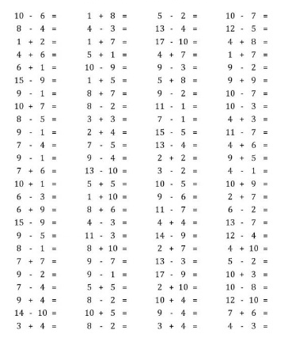
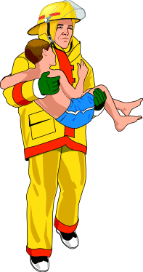
Drama Triangle
Perception of Maths as T.I.R.E.D.
(Nardi, Steward. 2003)
(Karpman. 1968)
Persecutor
Rescuer
Adult
Drama triangle related to Maths anxiety
Victim
Notes:
Fairly

Slide 8
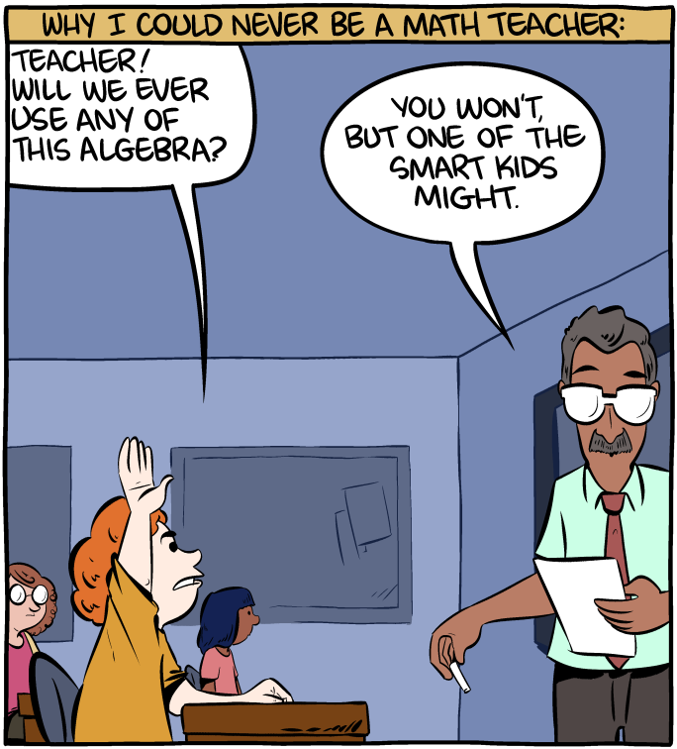
Perceptions of Maths at Bower Grove School: Moving forward

Slide 9
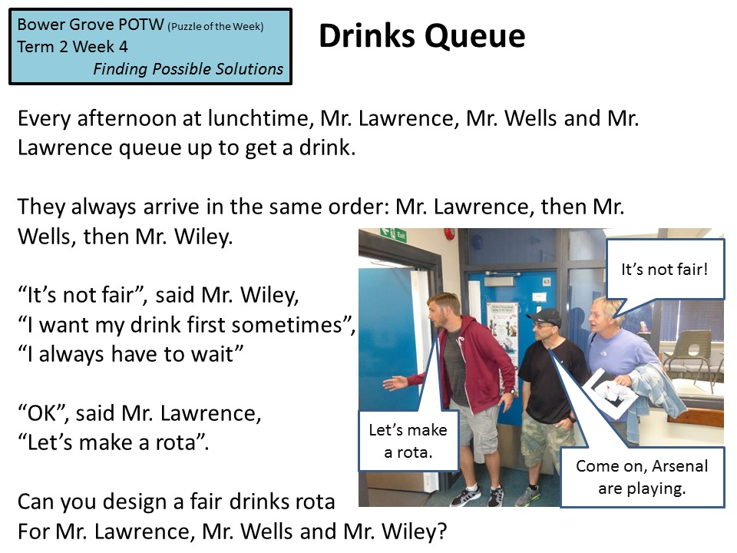
Challenging Perceptions of Maths
Problem Solving
POTW
Students writing POTW
Notes:
Perceptions of Maths: Problem solving being integral to the Maths we do – rather than stand alone – challenging perceptions of problem solving (its not scary) – construct around problem solving

Slide 11
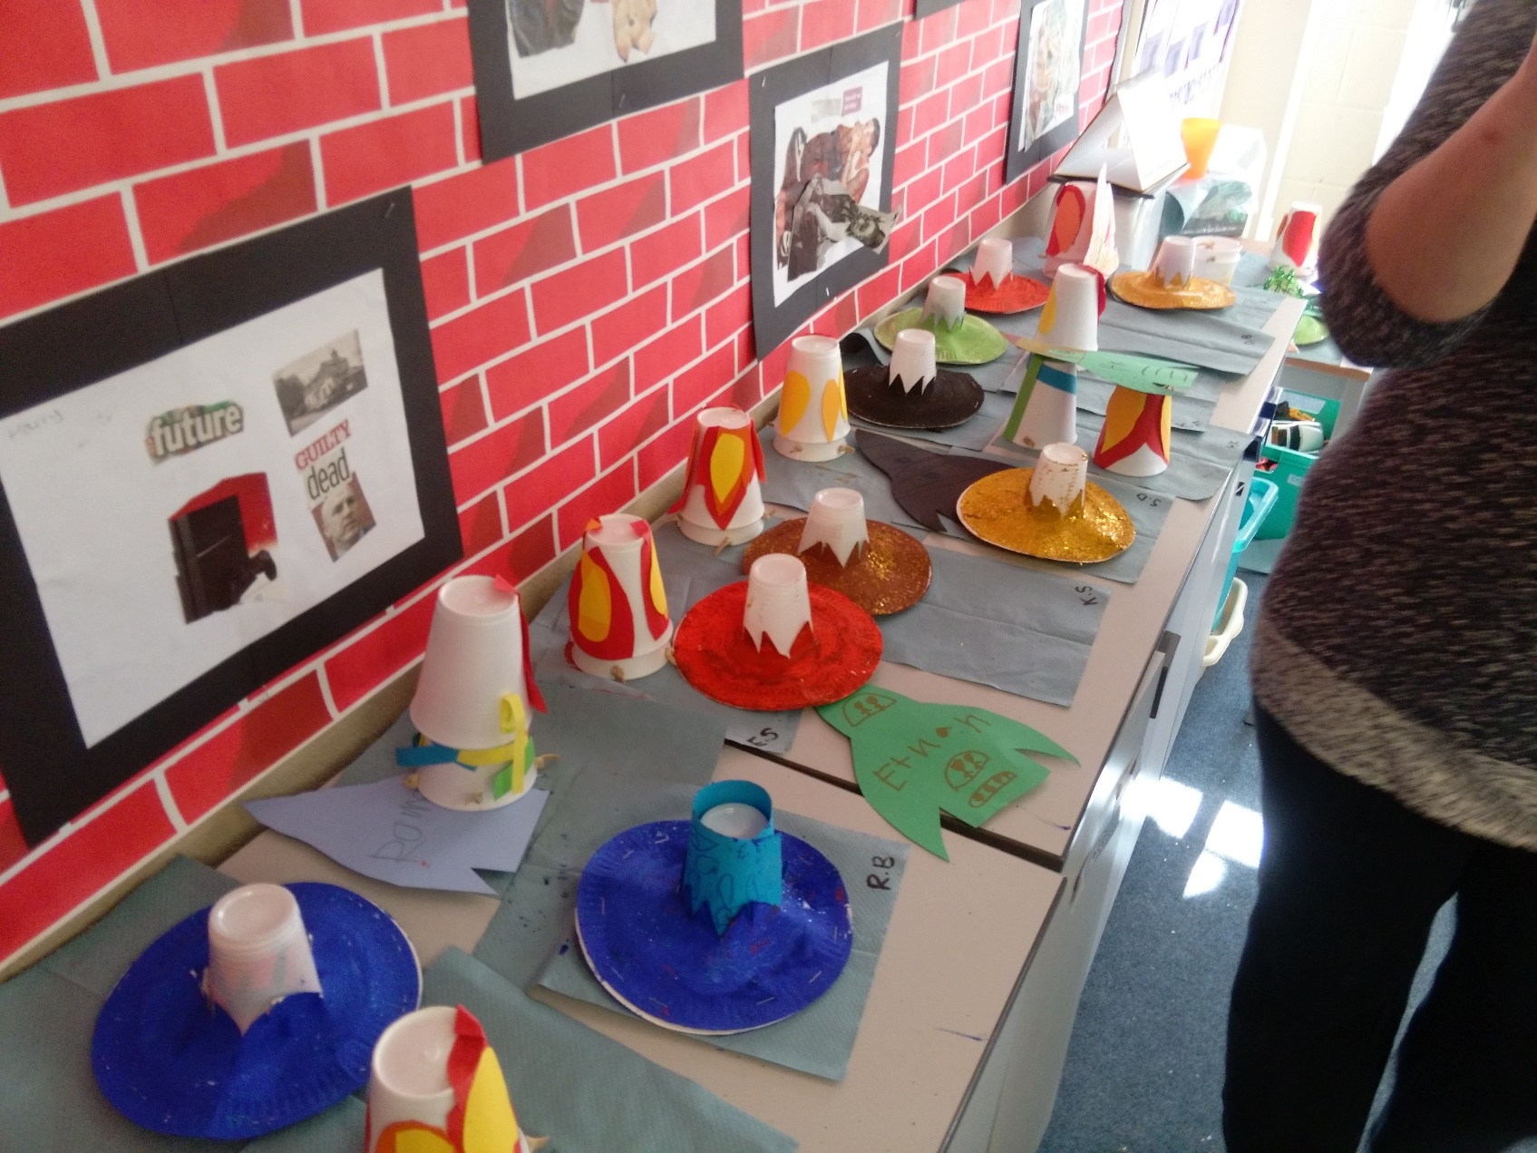
Challenging Perceptions of Maths
Focus days

Slide 12
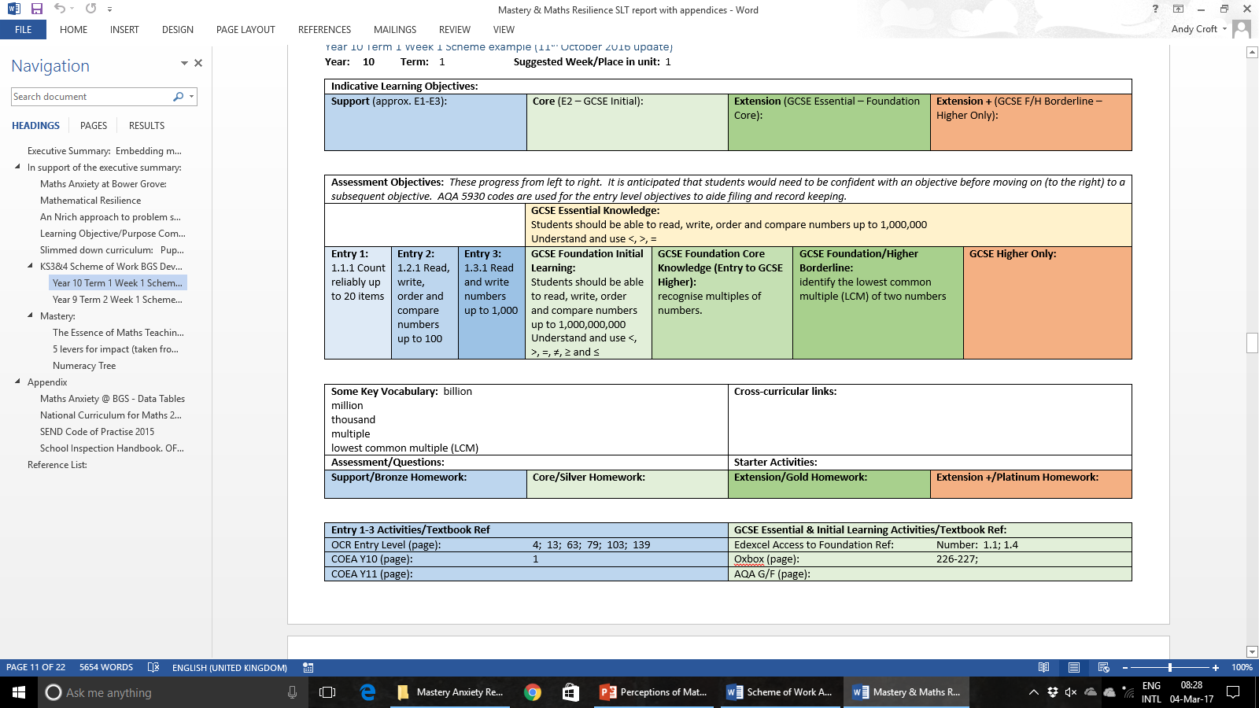
Challenging Perceptions of Maths
Schemes of Learning

Slide 15
Impact

Slide 18
Heather Geddes,
I don’t Know : 2016
http://www.thetcj.org/in-residence-articles/i-dont-know-heather-geddes
Later work has led me to appreciate the importance of houses, bridges, games, stories, play which help to express and clarify the issues blocking the learning process. But my basic proposal for beginning work with such profoundly disengaged children is that we address the foundations of ‘who am I, where am I and what time is it’ before we seek to erect the building of knowledge.
Notes:
Upon this briefly argued premise, I propose that the content of the curriculum for such profoundly vulnerable young people is addressed before any further plans to impart experience and knowledge begins. The pre-curriculum before the actual curriculum. As teachers we are rich in ideas about imparting learning and it was not difficult to prepare experiences and projects which addressed ‘who am I’ beginning with ‘what am I’. Working with a large outline drawing of their own shape they filled it in with organs and systems copied from books and supported by videos (yes it was some time ago) of how the body worked. The classroom filled up with new objects, a skeleton hung behind the door, they peered down a microscope at their own tissues, gasped at the idea that pregnancy resulted from two tiny cells joining together. The most wonderful moment was when they exchanged x and y chromosomes on cards to see whether their joined cells would make a boy or a girl baby. It was if the mysteries of the world were being revealed for the first time. Later they made models of the area and marked on where they lived, photo-ed their houses and streets and worked out on maps, what the places were that they passed through on the bus. More work went on about time – when is lunch, how long did it take, what time do we leave, time lines of their lives with details of the days and months of their birth – wars, disasters, festivals that they had heard about were added and very gradually a picture of themselves began to emerge which linked them into the real world and the world of others. The holes began to join up and so we began the City and Guilds maths group, what they wanted to learn about began to make sense and the possibility of joining up information into a coherent understanding became possible.
Later work has led me to appreciate the importance of houses, bridges, games, stories, play which help to express and clarify the issues blocking the learning process. But my basic proposal for beginning work with such profoundly disengaged children is that we address the foundations of ‘who am I, where am I and what time is it’ before we seek to erect the building of knowledge.
http://www.thetcj.org/in-residence-articles/i-dont-know-heather-geddes

